Slide 1
LUXURY VINYL FLOORING

Slide 2
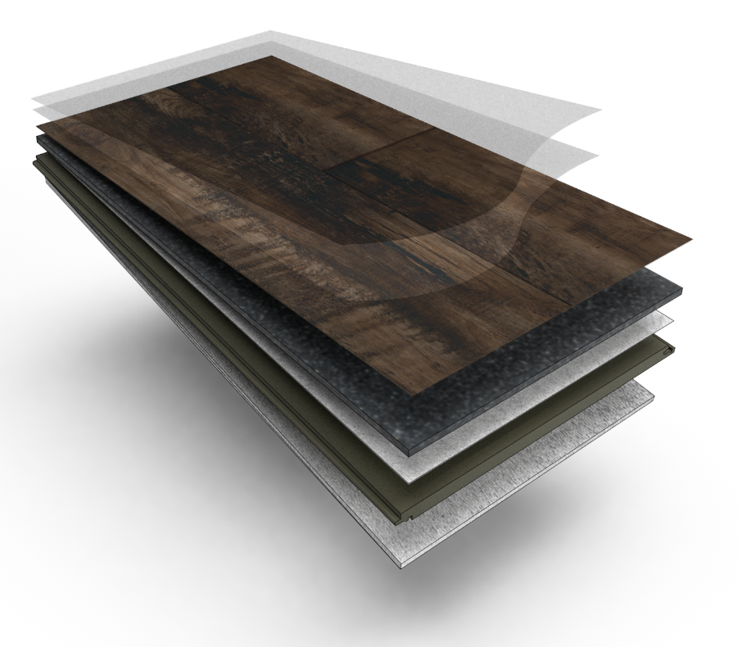
1
BELLAMY PLACE & ADVENTURO™
TECHNOLOGY BREAKDOWN
SuperGuardX™ Technology
Ultra-reinforced, commercially-graded shield added to the top wear layer that boosts durability and optimizes performance under heavy foot traffic – resists 3x more stains, scratches and scuffs
DuoPro™ Wear Layer
Vinyl wear layer that protects the print layer below and helps resist stains, scratches & scuffs
TrueVHD™ Print Layer
Created with the largest HD Print cylinders in the industry to create the most realistic, true visuals in the market
Multi Layer Inner Core
Provides increased dent resistance, stability and sound insulation while creating a bond between the visual layer and fiberglass layer
Woven Fiberglass Layer
Solid interlocking strands woven together to provide dimensional stability, which prevents expansion, contraction and dents
Multi Layer Rigid Backing w/ Uniclic® Locking
Densely constructed to provide superior strength and foundational support combined with Uniclic® locking system that allows for a fast and simple installation. Tiles easily click together, providing a seamless and strong joint – the strongest in the industry.
Foam Pad Underlayment
Built-in, closed-cell underlayment creates an added barrier that increases thermal/sound insulation and prevents mold

Slide 4
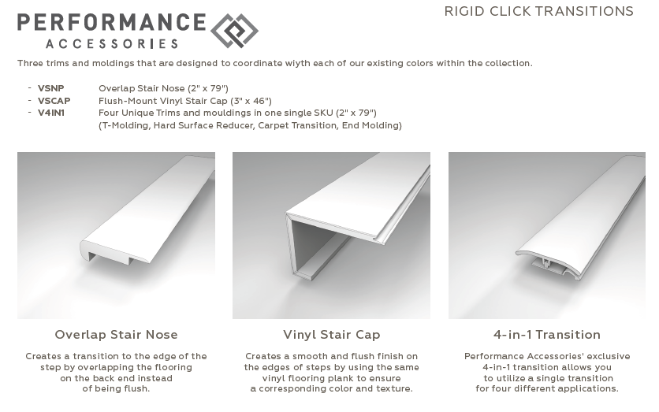
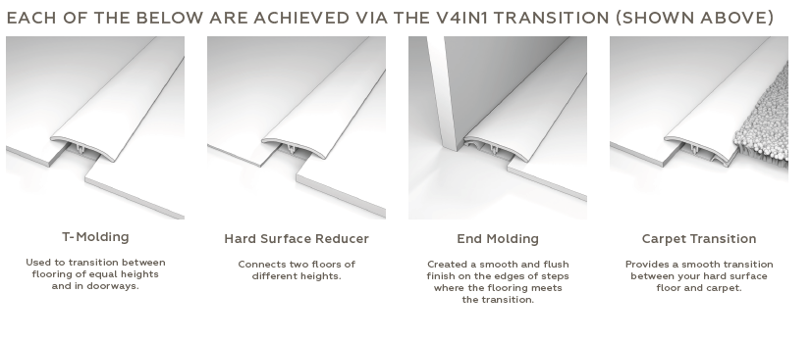

Slide 10
WARRANTY
What is the warranty?
Bellamy Place: 15 yr. Lt. Commercial, Lifetime Residential
Adventuro 7 yr. Lt. Commercial, 30 yr. Residential
Wellsridge: 15 yr. Lt. Commercial, Lifetime Residential
Langton: 10 yr. Lt. Commercial, 30 yr. Residential
Travane: 15 yr. Residential
Cyrose: 6 yr. Lt. Commercial, 15 yr. Residential
Bellant: 10 yr. Lt. Commercial, 15 yr.
Elixen: 10 yr. Lt. Commercial, 15 yr. Residential

